Slide 1
Fruit Fly Brain Observatory
http://fruitflybrain.org
https://github.com/fruitflybrain
An open-source collaborative research platform that integrates biological data with computational models, and serves as a meeting ground for researchers to study fruit fly brain function in health and disease.
Neuroinformatics tutorial
1.7 Open source initiatives
Notes:
<number>

Slide 2
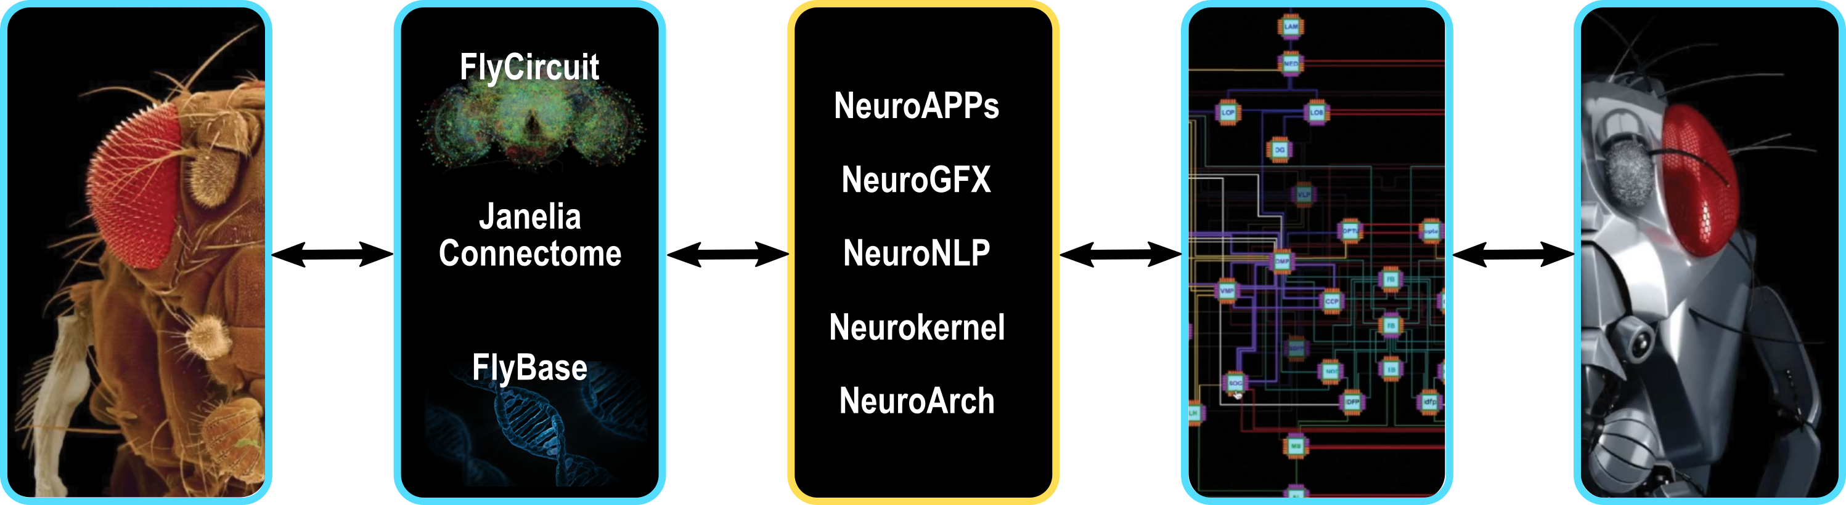
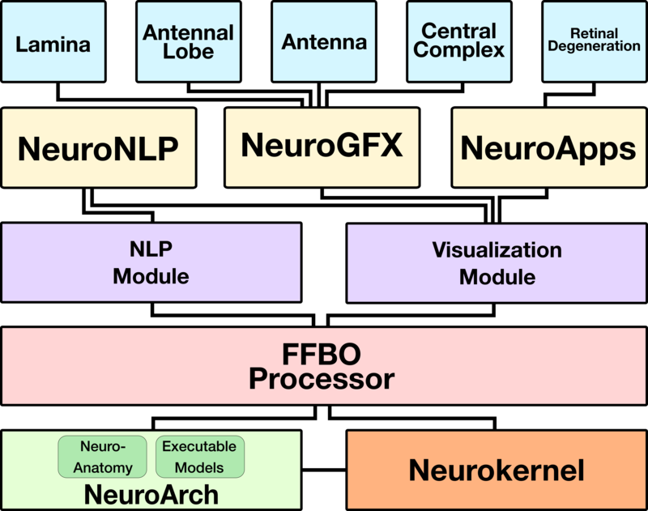

The Fruit Fly Brain Observatory (FFBO) aims to provide a meeting ground for researchers, including neurogeneticists/neurobiologists and theoretical/computational neuroscientists.
Neurobiologists
Neurogeneticists
Biological Data
FFBO
Brain Model
Computational/Theoretical
Neuroscientists
The FFBO presents two key applications to address, respectively, the following challenges:
NeuroNLP: seamlessly integrate structural and genetic data from multiple sources that can be intuitively queried, effectively visualized and extensively manipulated.
NeuroGFX: devise executable brain circuit models anchored in structural data for understanding and developing novel hypotheses about brain function.
Architecture of FFBO
Try NeuroNLP on your smartphone!
Notes:
<number>

Slide 3
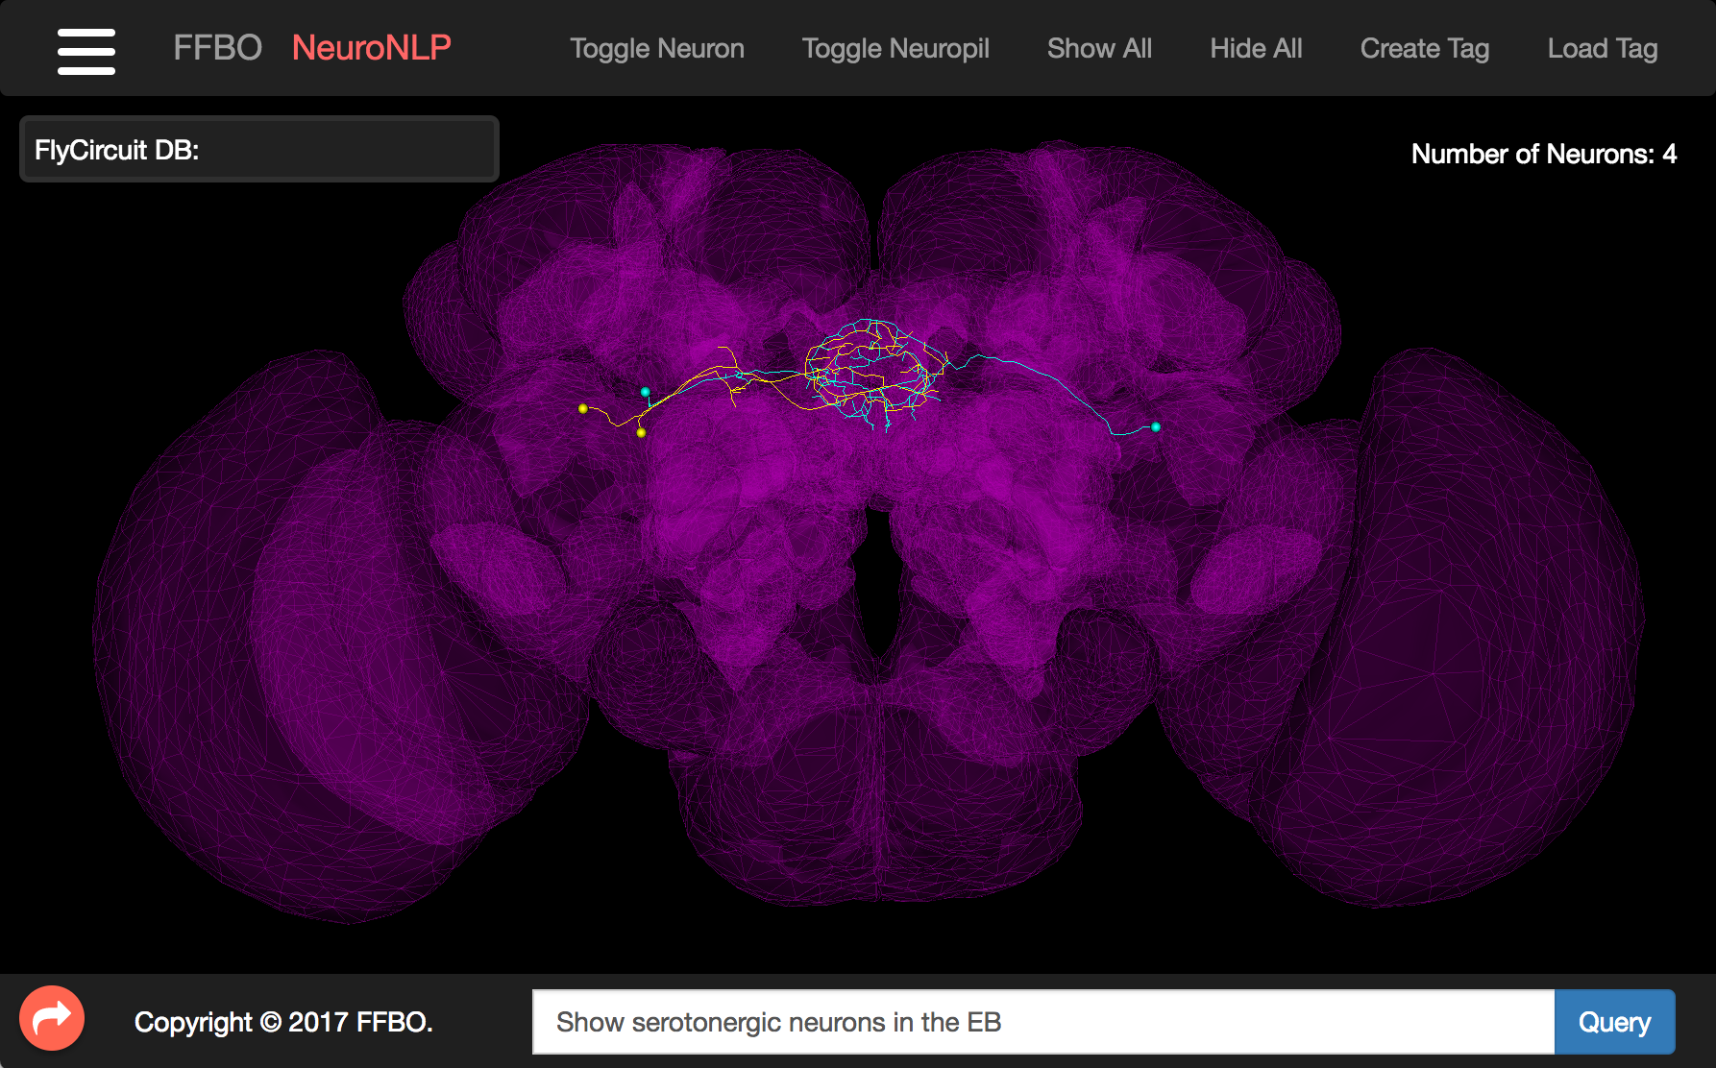
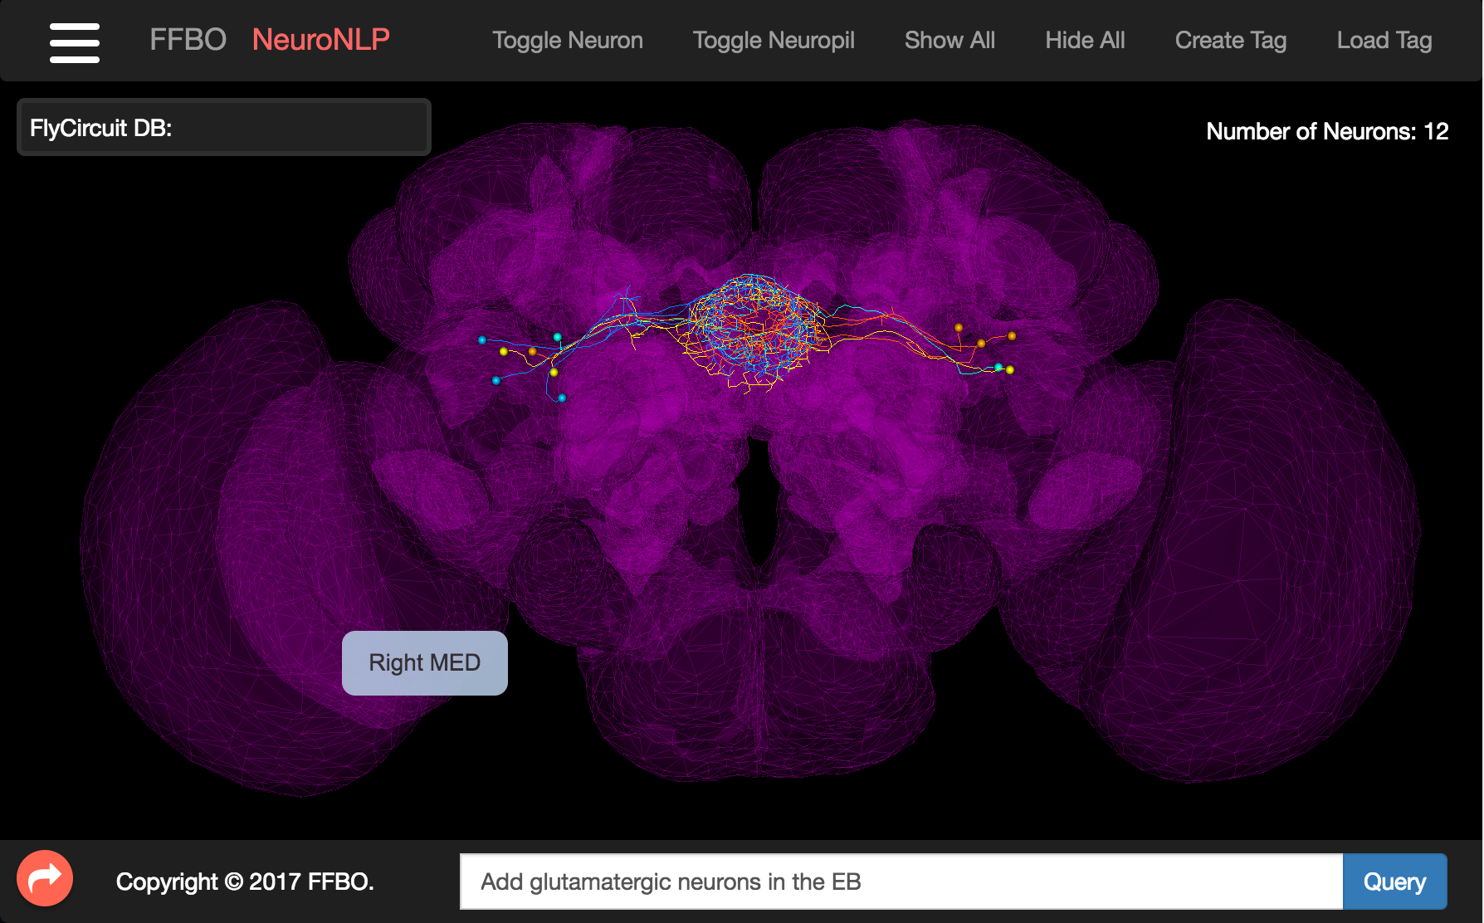
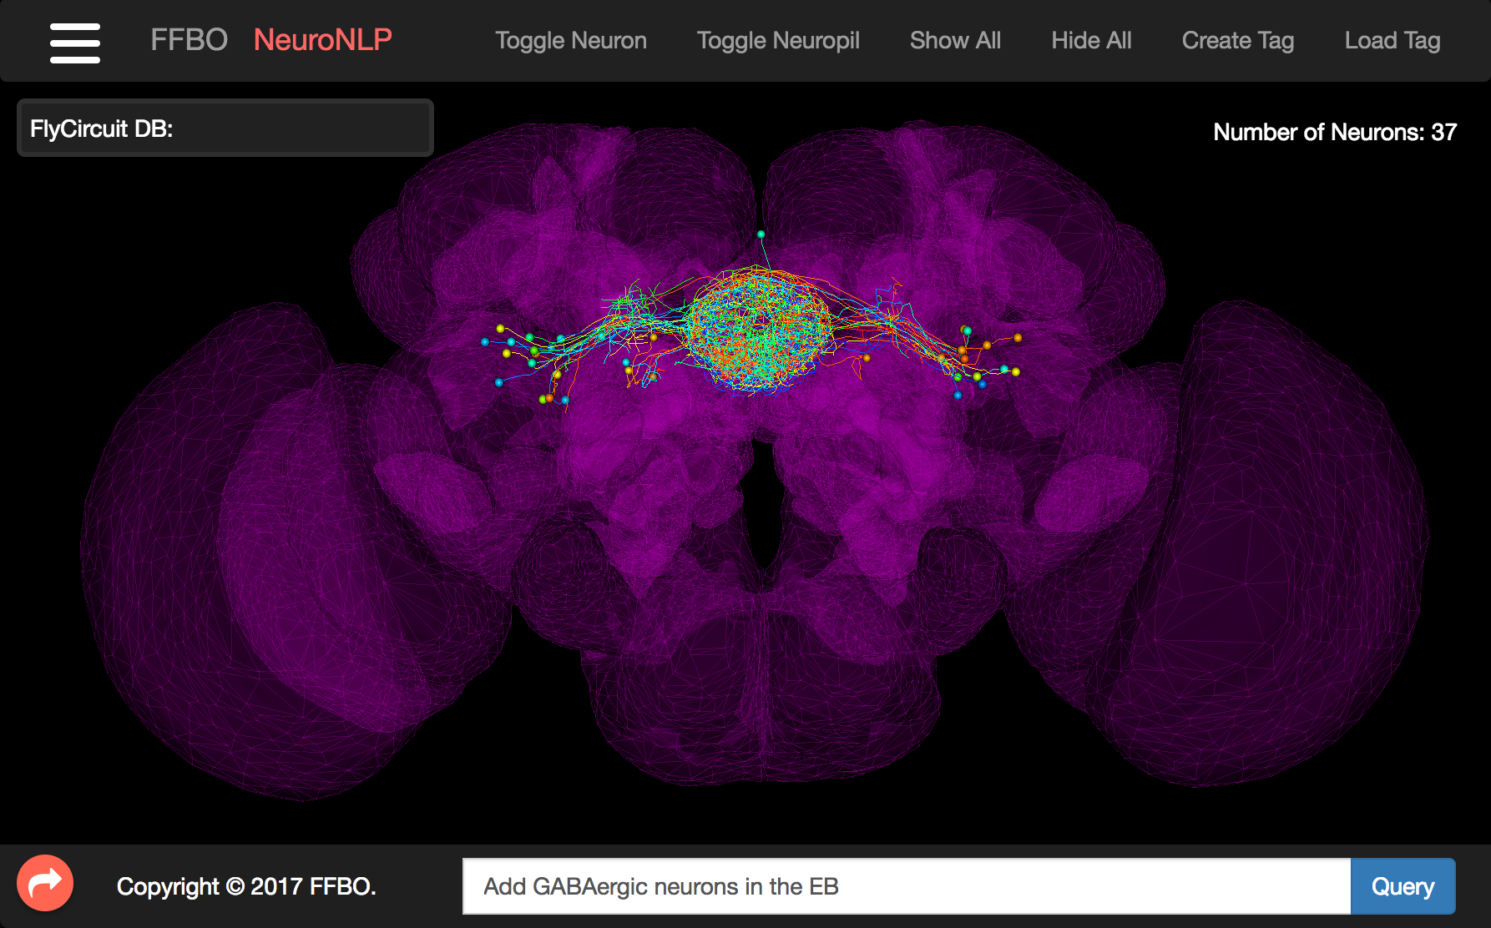

NeuroNLP: A Portal for Aggregated Fly Brain Data
https://neuronlp.fruitflybrain.org
A modern web-based portal for navigating fruit fly brain circuit data using natural language queries
1
2
Show serotonergic neurons in the EB
Add glutamatergic neurons in the EB
3
4
Add GABAergic neurons in the EB
Add cholinergic neurons in the EB
The final result can be tagged with a unique name (e.g. “EBdemo_step4”):
https://neuronlp.fruitflybrain.org/index.html?tag=EBdemo_step4
Additional Demos are available in the Exercises and on the NeuroNLP webpage under
NeuroNLP >>> Demos.
Notes:
<number>
NeuroNLP provides a modern web-based portal for navigating fruit fly brain circuit data using natural language queries. Combining data from multiple sources into a single database, with a common data model, NeuroNLP facilitates the access and retrieval of data from various sources simultaneously using the same queries.
Users can probe biological circuits in the NeuroArch database with plain English queries, such as “show glutamatergic local neurons in the antennal lobe” and “show neurons with dendrites in the mushroom body and axons in the fan-shaped body”.
The NLP module parses English queries into NeuroArch API calls. NeuroArch currently stores data from two sources: the FlyCircuit database and the Janelia Fly Medulla data, and is open to support additional data. The module can be flexibly replaced by other NLP modules to, for example, support different languages.
A user-friendly graphical user interface complements the natural language queries with additional controls for exploring neurons and neural circuits.

Slide 4
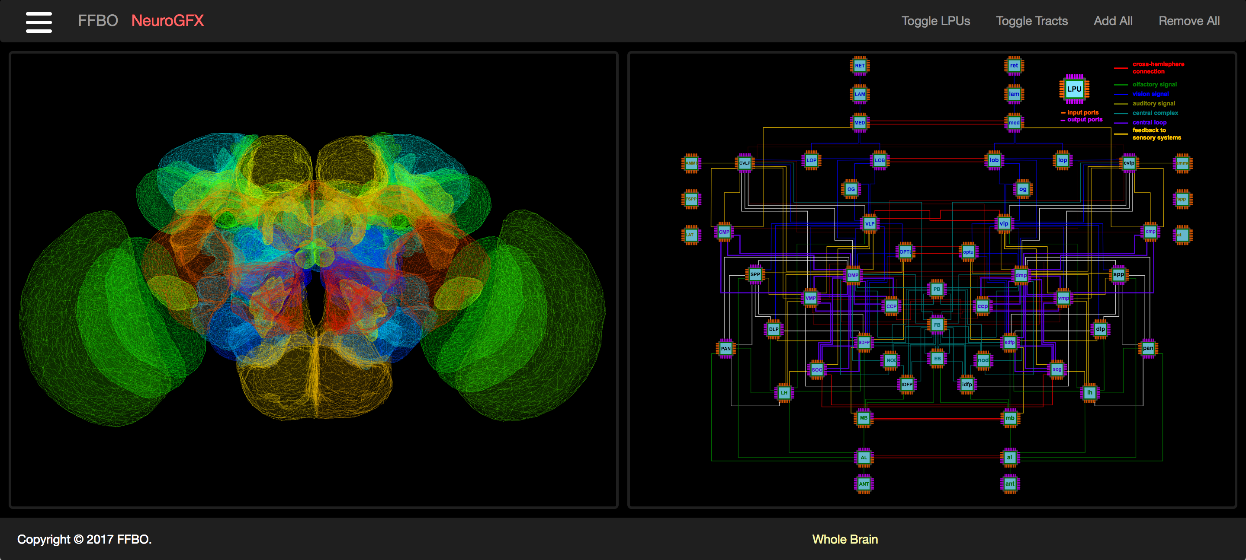
NeuroGFX: A Graphical Function Explorer for Fly Circuits
https://neurogfx.fruitflybrain.org
A set of highly intuitive tools to execute and explore the function of neural circuit models
Neural Circuit Function at Whole Brain Level
Additional Links:
Neural Circuit Function at Neuropil Level: Antennal Lobe
Neural Circuit Function at Local Circuit Level: A cartridge in the Lamina
The fruit fly brain is decomposed into some 50 neuropils, and they are shown on the left. The circuit diagram of the network of Local Processing Units, i.e., model abstractions of neuropils, is shown on the right.
Notes:
NeuroGFX is a set of highly intuitive tools to execute and explore the function of neural circuit models. It hosts a web based graphical interface that
associates circuit diagram with biological structural data,
supports manipulation of neural circuits in NeuroArch,
can initiate the execution of (manipulated) neural circuits in Neurokernel, visualize the execution results.
It provides an environment where
computational researchers can present configurable, executable neural circuits,
experimental scientists can easily explore circuit structure and function ultimately leading to biological validation.
With these capabilities, NeuroGFX enables the exploration of function from circuit structure at whole brain, neuropil, and local circuit level of abstraction
<number>

Slide 5
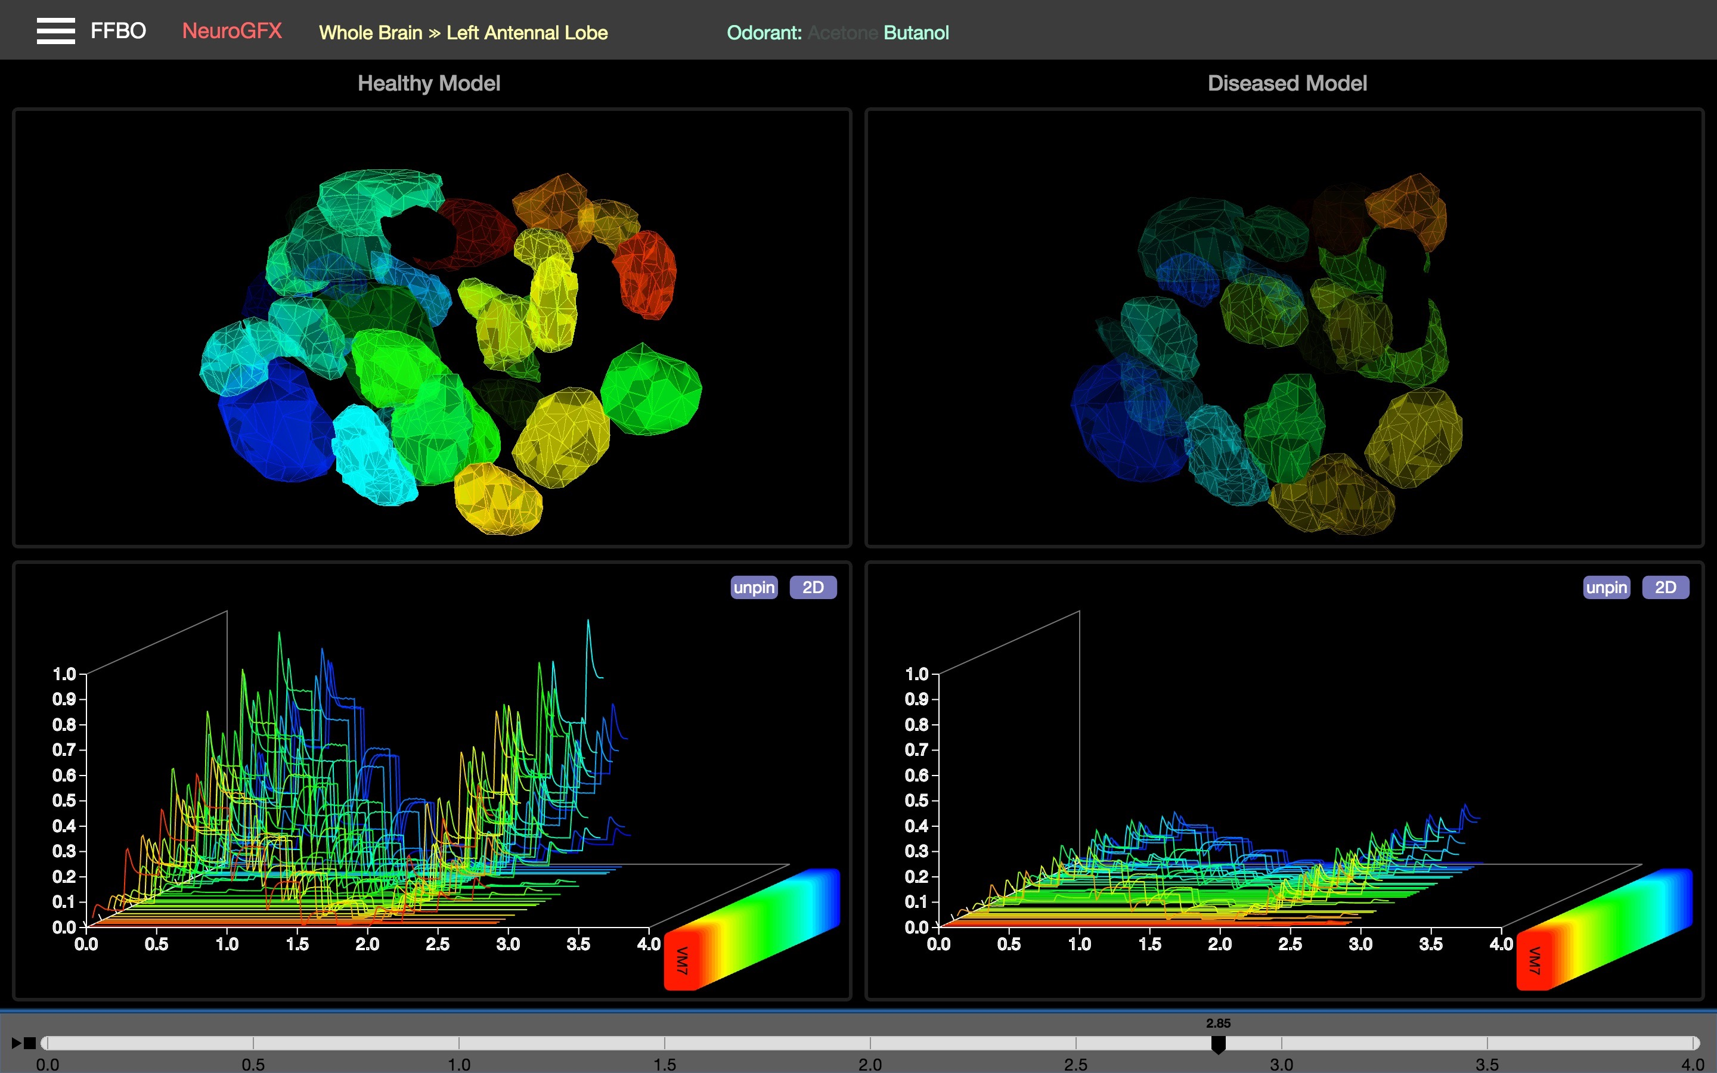
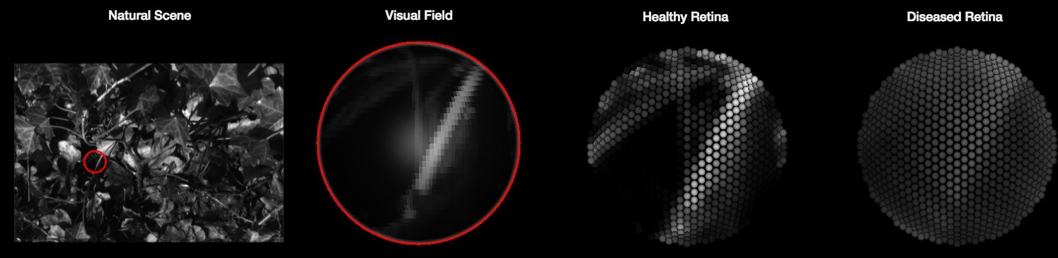
NeuroAPPs: Fly Brain Applications
Early Olfactory System Response in a Parkinson’s Disease Model
The prototype extends healthy antennal lobe implementation to the emulation of to pathological states of the olfactory system due to an excess release of GABA.
Early Visual System Response in a Parkinson’s Disease Model
A model of the retina with a novel adaptive photoreceptor capable of accurately reproducing visual responses under a wide range of stimuli.
Notes:
The FFBO platform has been designed from the bottom up to be modular and expandable, supporting both publicly and privately hosted databases, opening up the possibilities of community integrated 'NeuroAPPs', where healthy and diseased models of the fruit fly brain circuits are hosted.
<number>

Slide 6

Under The Hood
Representation and manipulation of neural circuits
Massively parallel execution of neural circuits on GPUs
NeuroArch
Neurokernel
An integrative Graph dB for Representation and Querying of Fruit Fly Brain Circuits
An Open Source Platform for Emulating the Fruit Fly Brain
https://neurokernel.github.io
NeuroArch (proposed in Neurokernel RFC #5) is a graph-based database that
supports integration of biological and modeling data,
facilitates the generation of executable models that are compatible with Neurokernel.
Its interface is designed to allows users to perform sophisticated queries without having to explicitly specify complex query strings
Neurokernel is a platform for the emulation of the fruit fly brain enabling the execution of arbitrarily defined circuit models on GPU clusters.
Execution of arbitrarily defined circuit models on GPU clusters.
Neurokernel API allows users to easily integrate models of different parts of the fly brain.
Neurokernel Request for Comments (RFCs) are publicly accessible design proposals for major new component, accompanied with code. https://neurokernel.github.io/docs.html
Notes:
<number>
Together, Neurokernel and NeuroArch serves as the “operating system” and the “database”, respectively, for executing a fruit fly brain model.

